Slide 1
Recent Deep Neural Networks for Automatic Speech Recognition
NPEX 2022 Speech

Slide 2
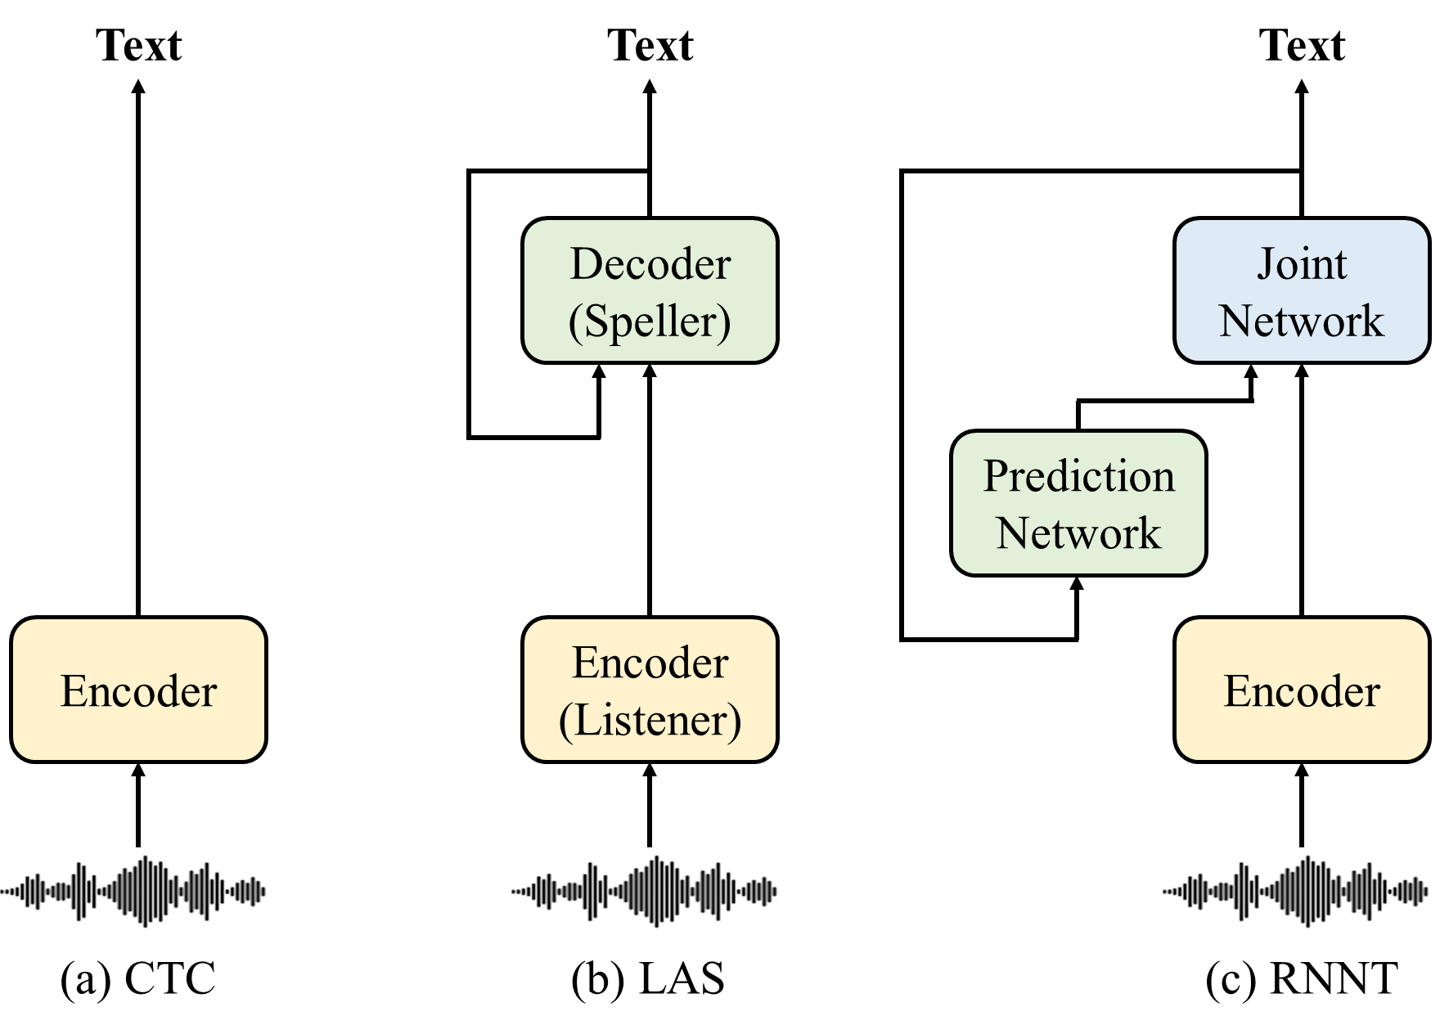
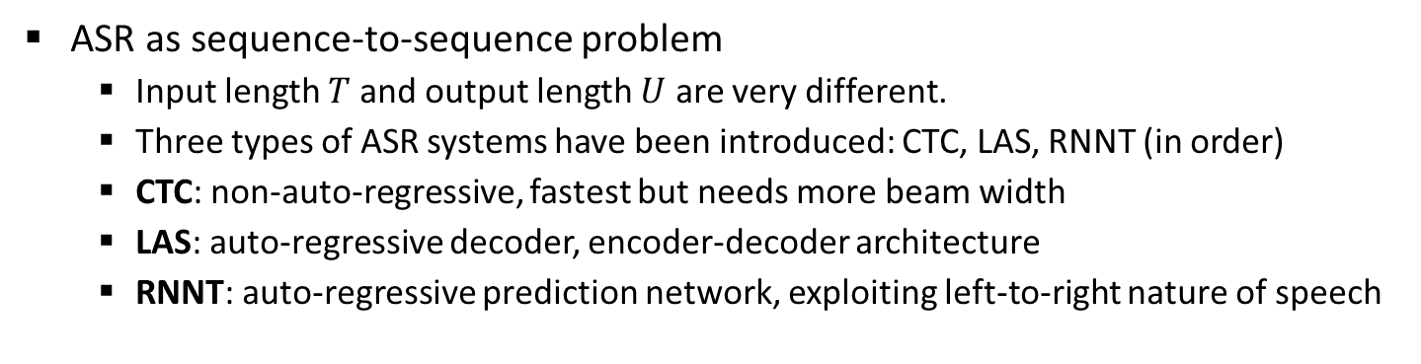
CTC, LAS, RNNT
ASR as sequence-to-sequence problem
Input length $T$ and output length $U$ are very different.
Three types of ASR systems have been introduced: CTC, LAS, RNNT (in order)
CTC: non-auto-regressive, fastest but needs more beam width
LAS: auto-regressive decoder, encoder-decoder architecture
RNNT: auto-regressive prediction network, exploiting left-to-right nature of speech

Slide 3
지금까지 다룬 Sequence Learning DNN Models
LSTM RNN – 가장 많이 사용되는 RNN 구조
장점: 비교적 훈련이 RNN 중에서는 잘 된다. 성능이 좋다.
단점: 출력이 한 샘플 씩 계산이 된다. 병렬처리 환경에서 불리하다.
QRNN – long term memory만 사용하고 short term feedback 을 사용 않는다. 대신에 입력을 추가 처리한다.
장점: 출력을 여러 개 한번에 계산할 수 있다.
단점: 성능 문제가 있다.
CNN, gated convnet – 정해진 길이의 convolution 을 사용한다.
장점: 출력을 여러 개 한번에 계산할 수 있다.
단점: 좋은 성능을 위해서는 convolution 의 길이를 늘려야 한다. 이 문제를 time-depth-wise 1-D convolution 을 이용해 해결하기도 하였으나 주로 mobile 용으로 사용된다.
Transformer model – 시간축의 연산을 모두 풀어놓고, 입력사이의 관계를 attention 을 이용해 파악.
장점: 좋은 성능 (과거를 길게 본다), 출력을 여러 개 한번에 계산 (특히 훈련 시에 유리), 잘 훈련이 된다 (LSTM RNN 대비 2, 3배 빨리 훈련된다)
단점: 길이가 길 경우 계산에 불리 (attention은 길이의 제곱 계산), 실시간 모델 만들기 어렵다 (내부 메모리 사용량 많다).

Slide 4
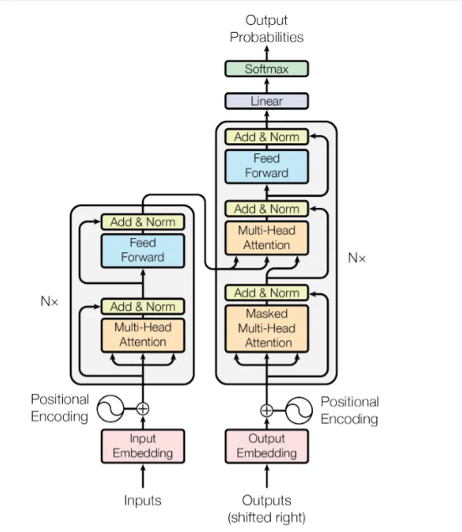
Transformer for Natural Language Processing

Slide 5
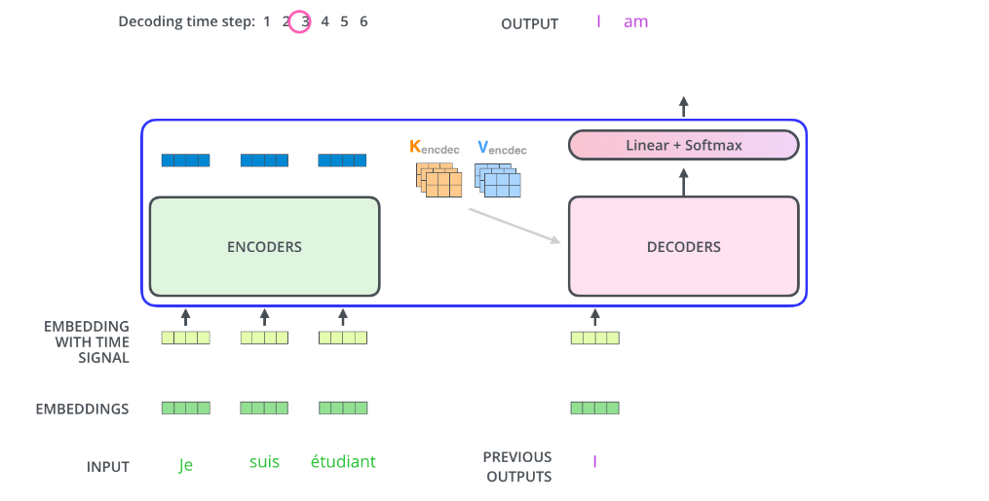
Attention and Transformers
How it works
02
Decoder’s
Output
Linear
Layer
But what about
Self-attention?

Slide 6
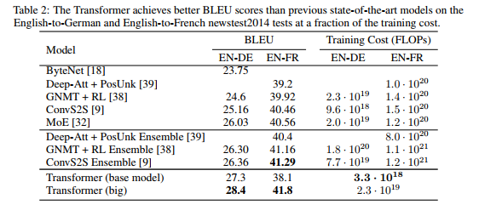
Attention and Transformers
Transformer Results

Slide 7
Transformer-based ASR

Slide 8
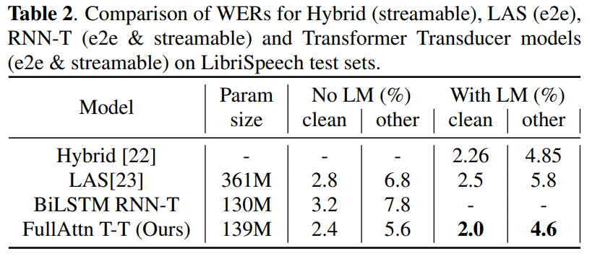

Transformer-Transducer
Transformer encoder for ASR
Mostly used with RNNT
Much faster training compared to LSTM (Transformer is fully parallelizable)
Much slower inference because of $O(T^{2})$ computation complexity
Transformer encoder + Transformer transducer
18-layer Transformer encoder + 2-layer Transformer prediction network
Relative positioning encoding (RPE) to embed the distance between frames
Good for streaming purpose when used with limited left & right context

Slide 9
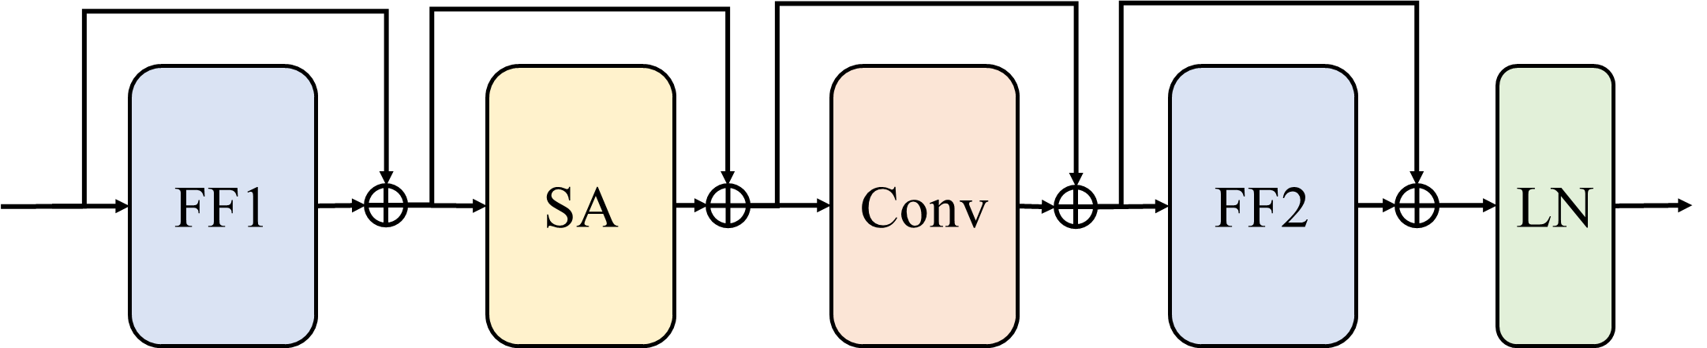
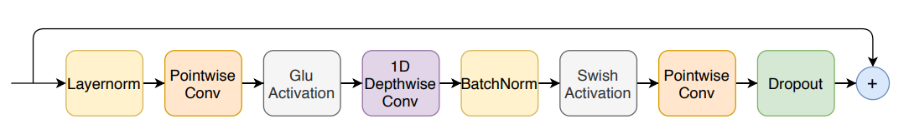
Conformer (RNNT)
Conformer-Transducer
A variant of Transformer with additional convolution module
Conv module supplements the locality-aware characteristics which is often weak in Transformer-based models
Time-domain 1D convolution
Fewer layers than CNN-based models
Fewer parameters than LSTM-based models
Used for many state-of-the-art ASR models
Conformer layer
Conv module inside Conformer layer

Slide 10
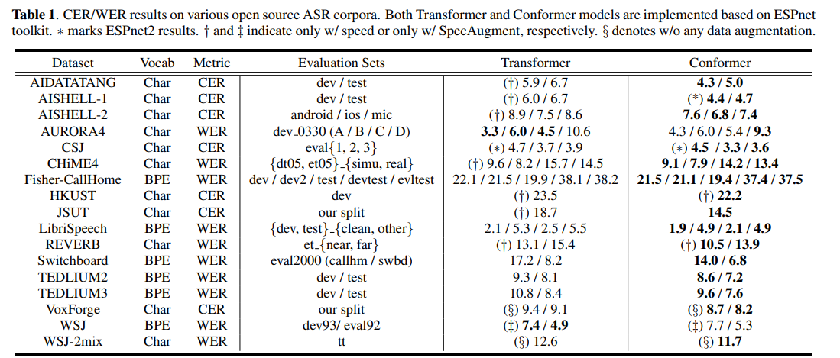
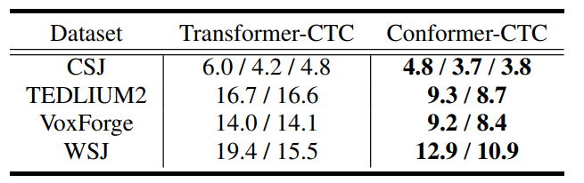
Conformer (CTC, LAS)
Conformer also shows superior performance with CTC and LAS frameworks
Conformer with LAS (=encoder + decoder)
Conformer with CTC

Slide 11
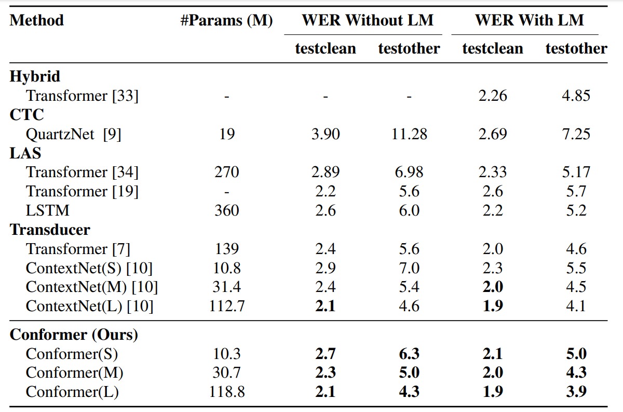
Recent DNN Models for ASR
DNN for sequence processing
Convolutional Neural Networks (CNN)
Long Short-Term Memory (LSTM)
Transformer / Conformer

Slide 12
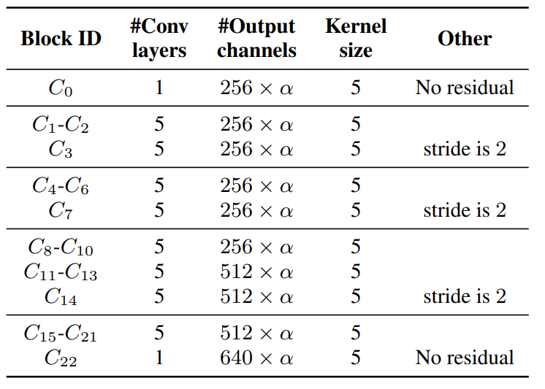
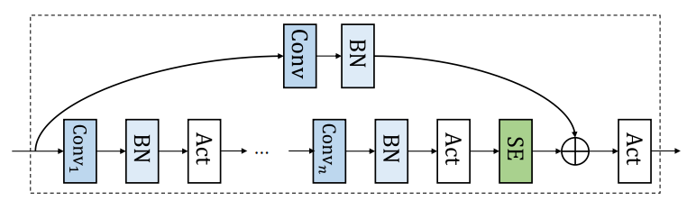

ContextNet (RNNT)
CNN encoder for ASR
Needs lots of #layers
Much fewer #parameters than LSTM
ContextNet = CNN encoder + RNN transducer
107 convolution layers with kernel size = 5
STFT with 10ms window → stride 3 times: 80ms per frame
SE (Squeeze-and-Excite)
Adaptively re-weight each feature dimension based on the input
Provide global perspective of the entire sequence
$C_{i}$ block

Slide 13
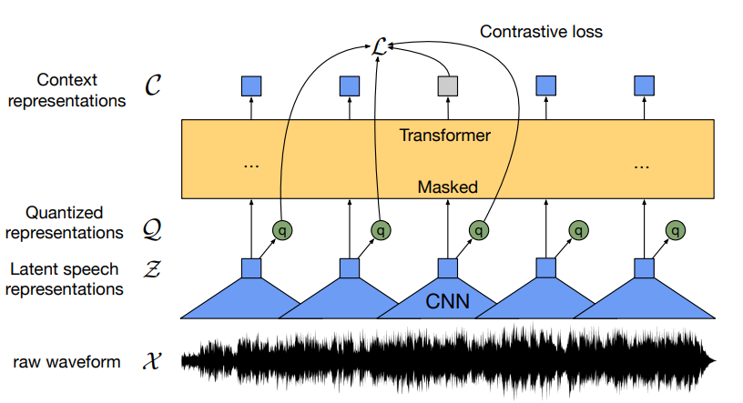
Wav2Vec 2.0
Self-supervised learning
Learn useful representations without label
Mask parts of waveform and train the model to predict the original values
12(base)/24(large)-layer Transformer encoder
Fine-tuning for ASR
Only 1-hour labeled data shows better result than previous 100-hour case
When using full 960-hour (LibriSpeech) data, Wav2Vec pre-training shows much higher recognition performance than training the model from scratch.

Slide 14
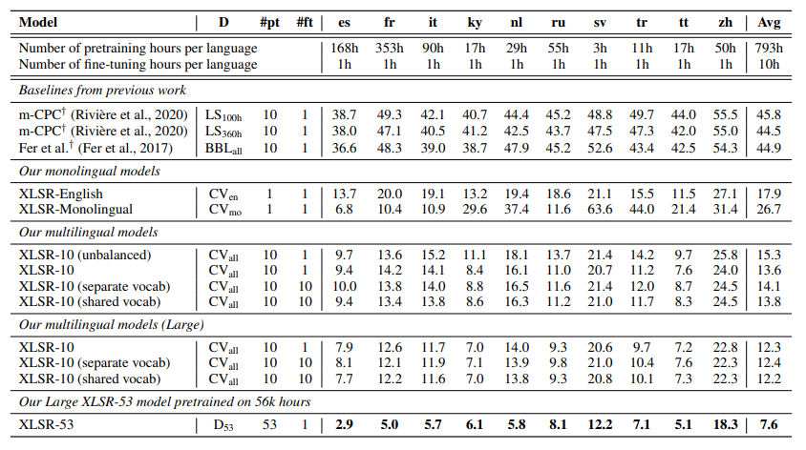
Wav2Vec XLSR
Extend Wav2Vec to learn general speech representations
Pre-trained encoder is used for multiple language ASR
Pre-trained with 53 languages, achieve SOTA for many low-resource languages
#pre-training
languages
Low-resource languages
State-of-the-art WER

Slide 15
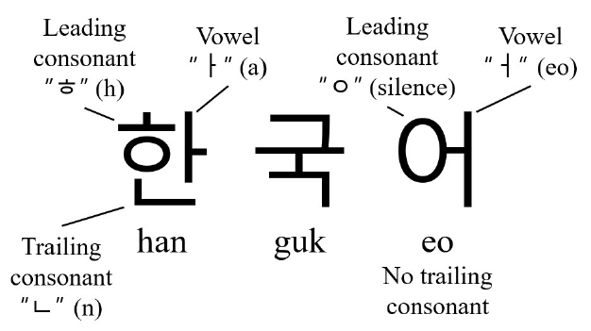
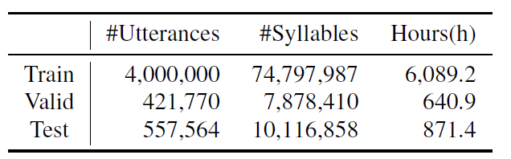
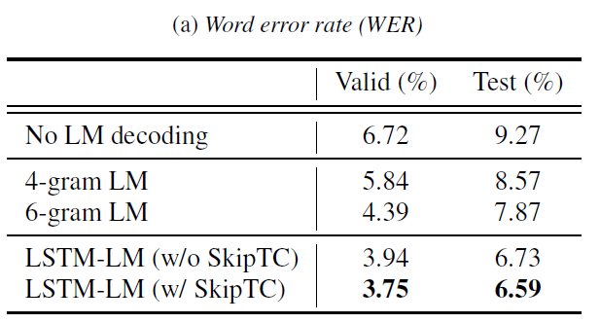
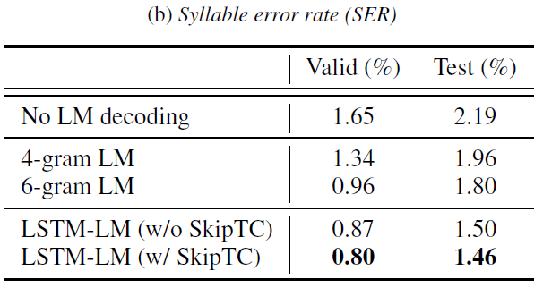
Korean Speech Recognition (Ours)
Korean ASR
Different tokenization (consonant + vowel)
Korean is now not a low-resource language; there is a lot of labeled data
Ex) Korean Free Conversation (한국어 자유 음성 대화) – 7,600 hours
We achieved WER(word error rate) 6.6%, SER(syllable error rate) 1.46% using 16-layer Conformer encoder with CTC

